Slide 1
Bluemix Operational Management
IBM Cloud Ecosystem Development team

Slide 2

Concepts of
Organizations, Domains Spaces, Users, and Quota
IBM Bluemix
Notes:
It’s important to understand Bluemix concepts and features. Describe the organization management elements in IBM Bluemix PaaS: Spaces, Users, Domains and Quota, Understand IBM Bluemix Regions and how to manage applications in multiple regions

Slide 3

Organization - The grouping methodology for users in Bluemix
Organization
Domains
Users
Quota
Spaces
Is defined by domains, spaces, users and quota. Organization name must be unique in Bluemix
Users in an org share memory and service instance quotas
Administrator can use Manage Organizations page on Bluemix dashboard to view ands manage the settings of the organization
Can be used to collaborate between users and to facilitate the logical grouping of project resources
When delete an organization, all the spaces, applications, and services within the organization are deleted.
Notes:
In IBM® Bluemix™, you can manage organizations and spaces, including user access, from the dashboard in the user interface. As an administrator, you can use the Manage Organizations page to view and manage the settings of the organization or space, including user access. To open the Manage Organizations page, on the menu go to user_name > Manage Organizations
In Bluemix, you can use organizations to collaborate between users and to facilitate the logical grouping of project resources in the following ways:
You can be the owner of your own organization, and you can also be the member of other organizations.
You can group a set of spaces, applications, services, domains, routes, and users together in organizations.
You can govern the access to the resources of organizations on a per-user basis.
When you create an organization, the organization name must be unique in Bluemix. After you create the organization, you will be automatically assigned Organization Manager permission, which enables you to edit the organization name, delete the organization, and create spaces in the organization.
When you delete an organization, all the spaces, applications, and services within the organization are deleted.
Bluemix enables collaboration on projects by assigning users within an organization and within the spaces in the organization. You can use the USERS tab to display and manage users of the organization.

Slide 4
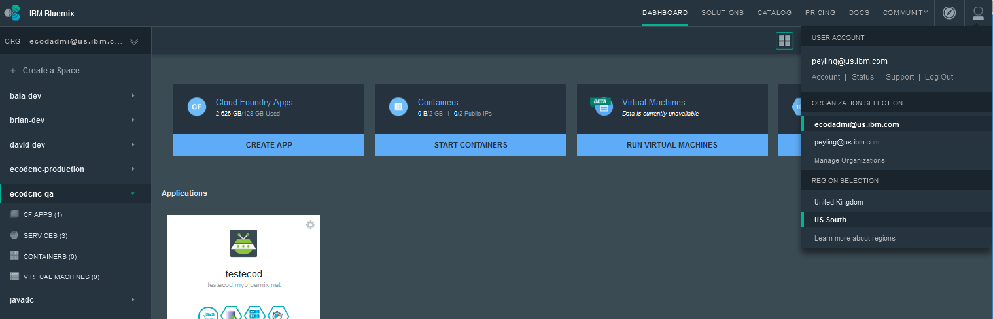
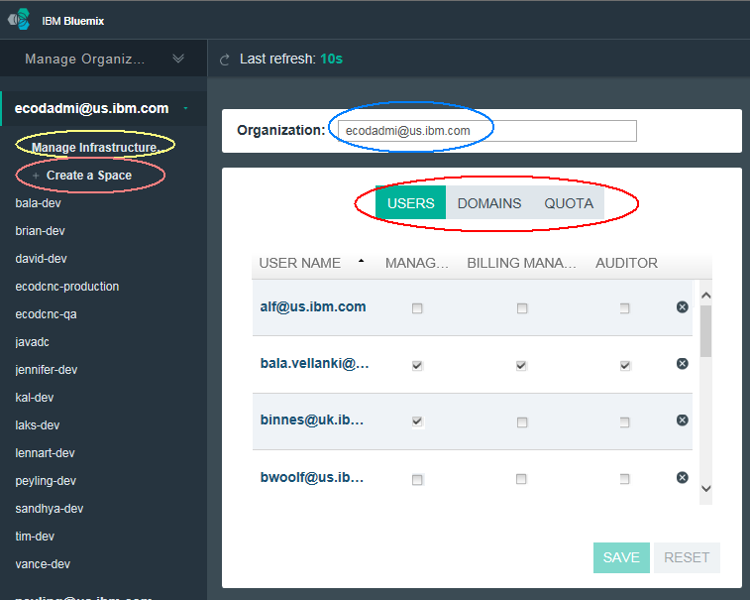
Manage Organizations from Bluemix Dashboard
Current
organization.
1. Click to show drop down list.
Current
Region
2. Click to select Management Organizations option from drop down list.
Notes:
From Bluemix dashboard you can see your current organization and Region. Click on the right top most icon to show a drop down list. You can select the organization to work on or change the Bluemix region from the drop down list. You can click on Management Organizations from drop down list to show a wizard to manage spaces, users domains and quota of current organization (i.e ecodadmi@us.ibm.com).

Slide 5
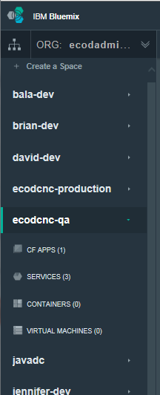
Space – An Organization unit and A sub-group within Bluemix Org
Contains applications and services in the Cloud Foundry infrastructure and can be used to store and track application resources
An organization can contain multiple spaces. In Bluemix, you must associate all the applications and services that you create with a space.
Users who are members of an org are given access to one or more of its spaces, with permissions associated with a particular role (such as developer, manager, or auditor).
Any member of the space can view apps, but only members with the developer role can create apps and add service instances to the space.
Applications and service instances are associated with spaces
Notes:
Spaces provide a mechanism to collect related applications, services, and the users that can collaborate on the resources. An organization can contain multiple spaces. All application and service creation within BluemixTM must be associated with a space.

Slide 6
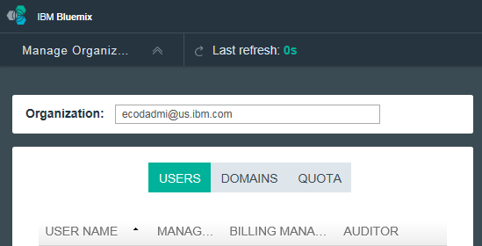
Bluemix User – The basic role in organizations and spaces
Bluemix user must be assigned to an organization before the user can be granted permissions to the spaces within the organization.
User can switch organizations and view resources of only one organization at a time
An user can be either a member or a collaborator of an organization:
  You are a collaborator of an organization, if you already have a Bluemix account, and someone else invites you to the organization.
  You are a member of an organization if you don't have a Bluemix account, but then someone invites you to the organization and you sign up for Bluemix from the invitation.
Notes:
A user must be assigned to an organization to be granted permission to the spaces within the organization.
Quota represents the resource limits for the organization. Quota defines the number of services and the amount of memory that can be allocated for use by the organization. Any application or service in a space of the organization contributes to the usage of the quota. The quota is assigned when organizations are created.

Slide 7
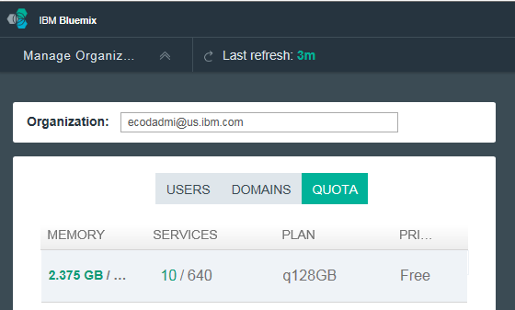
Bluemix Quota – The organization resource limits
Represents the resource limits for the organization and defines the number of services and the amount of memory that can be allocated for use by the organization.
Any applications or services in a space of the organization contributes to the usage of the quota.
The quota is assigned when organizations are created.
Notes:
In Bluemix, Organizations are used to manage quotas. Users in an org share memory and service instance quotas
Quota represents the resource limits for the organization. Quota defines the number of services and the amount of memory that can be allocated for use by the organization. Any application or service in a space of the organization contributes to the usage of the quota. The quota is assigned when organizations are created.
The example shows the ecodadmi@us.ibm.com org has 2.375GB of memory and 10 services in use. The resources limits of the org are 128G memory and 640GB

Slide 8
Bluemix Roles and Permissions
Organization Roles
  Organization users can view the settings of the organization
  Organization managers can create spaces and add users to the organization or spaces.
  Billing managers can view organization charges.
  Auditors can view all organization and space content.
Space Roles
  Space managers can add users to the space.
  Developers can add and configure applications and services.
  Auditors can only view content in the space.

Slide 9
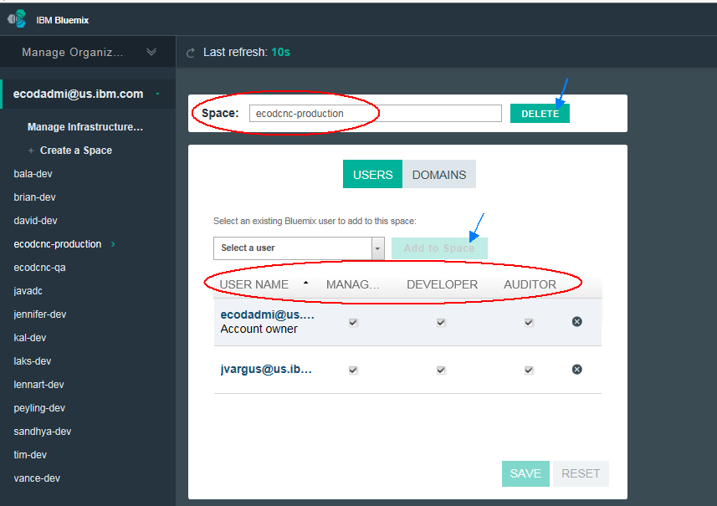
Managing Roles and Permissions of Space
Notes:
In Bluemix, Applications and services are associated with Space. Every members of the Space can review apps and services, only users with Developer role can create applications in the space.
You can add users into the Space, delete users and grand Manager, Developer or Auditor permissions to the user by using Manage Organization wizard. You need to have Org admin privilege to delete any user Space

Slide 10
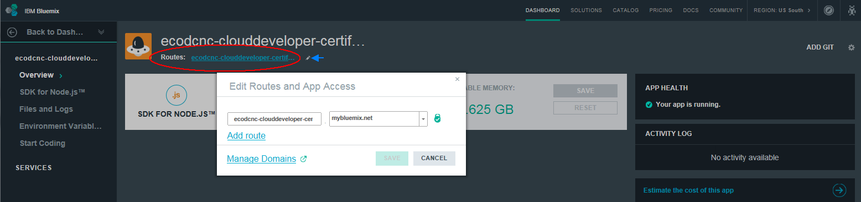
Bluemix Routes
The URL used to direct requests to an application.
A route is made up of an optional host (or subdomain) and a domain that are specified when an application is pushed.
A route can be associated with one or more applications. Unless a custom domain is specified, Bluemix uses a default shared domain in the route to your application.
Notes:
The URL used to direct requests to an application. A route is made up of an optional host (or subdomain) and a domain that are specified when an application is pushed. For example, in the route myapp.example.com, myapp is the host and example.com is the domain. A route can be associated with one or more applications. Unless a custom domain is specified, Bluemix uses a default shared domain in the route to your application.

Slide 11
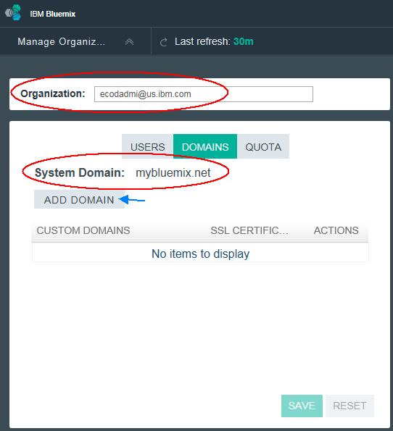
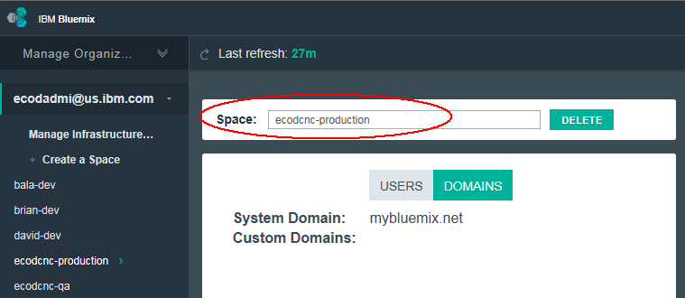
Bluemix Domains
Provide the route on the internet that is allocated to the organization. A route has a sub-domain and a domain. A sub-domain is typically the application name. A domain might be a system domain, or a custom domain that you registered for your application.
Part of a naming hierarchy that specifies the route. For example, example.com.
In Bluemix, domains are associated with orgs. Domain objects are not directly bound to apps
Notes:
Domains provide the route on the Internet that is allocated to the organization. A route has a sub-domain and a domain. A sub-domain is typically the application name. A domain might be a system domain, or a custom domain that is the personally registered for your application. Note: If you add a custom domain, you must configure your DNS server to resolve your custom domain to point to the Bluemix system domain. In this way, when Bluemix receives a request for your custom domain, it can properly route it to your application

Slide 12
Concept of
Regions
IBM Bluemix
Notes:
IBM Cloud offers Bluemix to multiple GEO /World Wide to serve our customer needs. It’s critical to understand IBM Bluemix Regions and how to manage applications in multiple regions to provide better support to your WW customers.

Slide 13
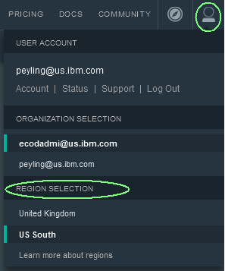
Bluemix Region– A Defined Geographical Territory for App Deployment
A unique prefix, CF API endpoint & UI console are assigned to each region
Applications and service instances can be created in different regions with same Bluemix infrastructure
You can switch to a different region to work with the spaces in that region from Bluemix Dashboard UI Console after log in to Bluemix
If using the cf command line interface, you must connect to the Bluemix region that you want to work with by using the cf API command and specifying the CF API endpoint of the region. For example,
  $ cf api https://api.eu-gb.bluemix.net
Bluemix region list
Region name | Region prefix | CF api endpoint | UI console
US South region | us-south | api.ng.bluemix.net | console.ng.bluemix.net
Europe United Kingdom region | eu-gb | api.eu-gb.bluemix.net | console.eu-gb.bluemix.net
Notes:
What is Bluemix Region? A Bluemix region is a defined geographical territory that you can deploy your applications to. You can create applications and service instances in different regions with the same Bluemix infrastructure for application management and the same usage details view for billing. You can select the region that is nearest to your customers and deploy your apps to this region to get low application latency. You can also select the region where you want to keep the application data to address security issues. When you build apps in multiple regions, if one region goes down, the apps that are in the other regions continue to run. Your resource allowance is the same for each region that you use.
If you are using the Bluemix user interface, you can switch to a different region to work with the spaces in that region.
If you are using the cf command line interface, you must connect to the Bluemix region that you want to work with by using the cf API command and specifying the API endpoint of the region. For example, enter the following command to connect to Bluemix Europe United Kingdom region:
cf api https://api.eu-gb.bluemix.net
If you are using the Eclipse tools, you must connect to the Bluemix region that you want to work with by creating a Bluemix server and specifying the API endpoint of the region. A unique prefix is assigned to each region. Bluemix provides the following regions and region prefixes.

Slide 14
Manage Applications in Multiple Bluemix Regions
Applications and service instances can be created in different regions.
Select the region that is nearest to your customers and deploy your apps to this region to get low application latency.
Select the region where you want to keep the application data to address country regulatory and security issues.
When build apps in multiple regions, if one region goes down, the apps that are in the other regions continue to run.
Your resource allowance is the same for each region that you use.
Services available in Bluemix catalog and service plan might not the same across regions
Notes:
Bluemix offers multiple regions. You can create applications and service instances in different regions with the same Bluemix infrastructure for application management and the same usage details view for billing. You can select the region that is nearest to your customers and deploy your apps to this region to get low application latency. You can also select the region where you want to keep the application data to address security issues. When you build apps in multiple regions, if one region goes down, the apps that are in the other regions continue to run. Your resource allowance is the same for each region that you use.
If you are using the Bluemix user interface, you can switch to a different region to work with the spaces in that region.
If you are using the cf command line interface, you must connect to the Bluemix region that you want to work with by using the cf API command and specifying the API endpoint of the region. For example, enter the following command to connect to Bluemix Europe United Kingdom region:
cf api https://api.eu-gb.bluemix.net

Slide 15
Bookmarks & References
https://www.ng.bluemix.net/docs/#services/services.html
https://www.ng.bluemix.net/docs/#overview/overview.html#overview
https://www.ng.bluemix.net/docs/#overview/overview.html#ov_intro__reg
http://docs.cloudfoundry.org/devguide/installcf/whats-new-v6.html
https://www.ng.bluemix.net/docs/#
http://docs.cloudfoundry.org/devguide/installcf/whats-new-v6.html#domains-etc

Slide 16
QUESTIONS?
Get help from Bluemix development team and Stack Overflow community
Visit: HTTPS://IBM.BIZ/BDXGBL
Notes:
Please post your questions or find the answers on Bluemix Community https://ibm.biz/BdXGBL

